Slide 1

MA2012 INTRODUCTION TO MECHATRONICS SYSTEMS DESIGN
Lecture 4
Prof Ang Wei Tech
College of Engineering
School of Mechanical and Aerospace Engineering

Slide 2
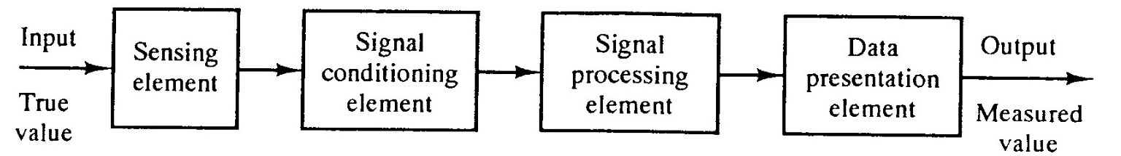
RECAP
Digital Sensors
Switches, Incremental Encoder
Interfacing with Digital Sensors
ANALOG SENSORS
Analog Output (e.g. Potentiometer), Digital and Analog Outputs (e.g. accelerometer)
Acquisition process and elements
Digitization of analog signal
Shannon sampling theorem, Nyquisit frequency, Aliasing
A/D Conversion, ADC
Successive Approximation
Flash Converter

Slide 3
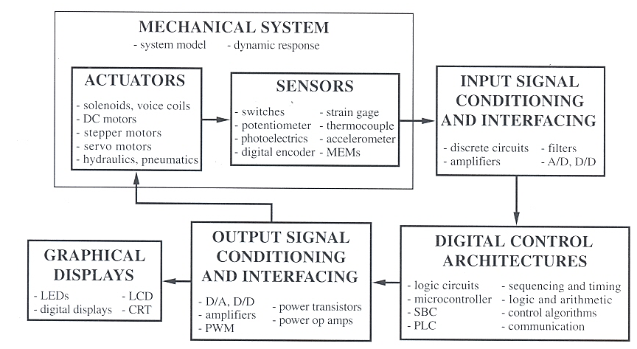
MECHATRONIC SYSTEM COMPONENTS

Slide 4
TYPES OF ACTUATORS
MA2012 covers
DC Motor
Stepper Motor
Servo
Solenoid
Types not covered
AC Motor
Hydraulic Actuator
Pneumatic Actuator
Piezoelectric Actuator
Shape Memory Alloy

Slide 5
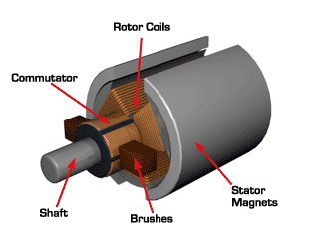
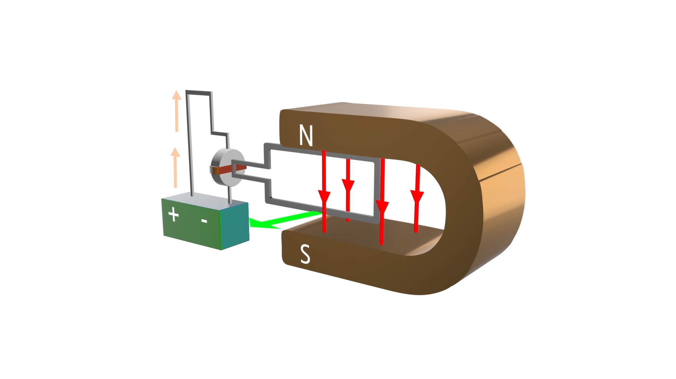
DIRECT CURRENT MOTOR
Permanent Magnet or Brushed DC Motors
Stator: external, fixed
Rotor: internal, rotates
Click animation to play

Slide 6
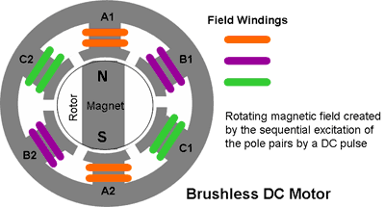
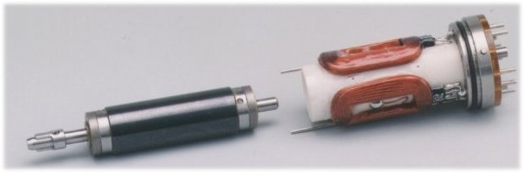
DIRECT CURRENT MOTOR
Brushless DC Motor
Brushed motor inside-out
Permanent magnet rotor
Stator with rotating magnetic field
Need to know exact angular position of the rotor so as to excite the correct coils
Typically with
Hall effect sensors
permanent
magnet
coils
shaft
rotor
stator

Slide 7
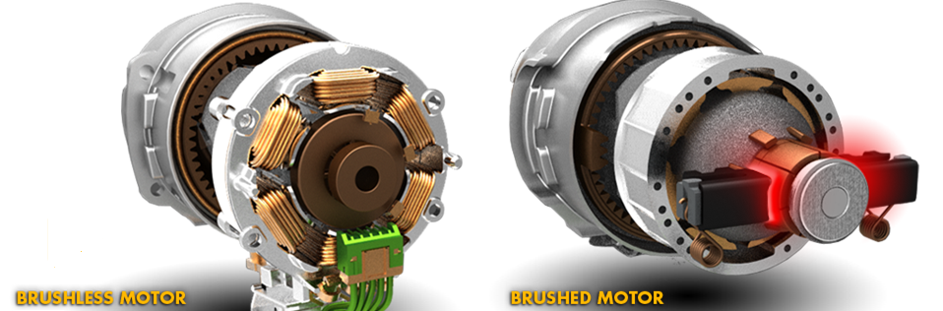
DIRECT CURRENT MOTOR
Brushless | Brushed
Simple maintenance | Low cost: simple construction & control, only two wires needed
High efficiency: No drop in voltage across brush, low electrical noise | More robust in harsh environment, because no electronic components
Higher speed range
Reduced size

Slide 8
CONTROLLING DC MOTORS
Motion Control Fundamentals
Power = VI = τω
DC motor control
Voltage controls velocity: V ∝ ω
Current controls torque: I ∝ τ
Using power amplifiers is possible but is typically avoided
Large power dissipation, over-heating of the amplifier
Digital-to-Analog Converter (DAC) is expensive
Most MCUs are not equipped with a DAC
Solution:
Pulse Width Modulation (PWM)

Slide 9
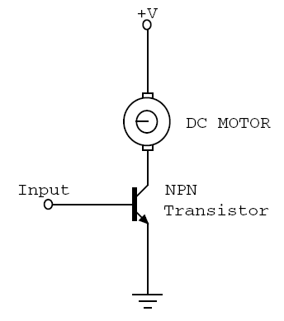
CONTROLLING DC MOTORS
+V
Power Amplifier
MCU
DAC
Variable Speed
Constant Power
Variable Torque
i

Slide 10
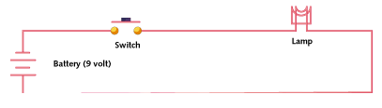
PULSE WIDTH MODULATION
If switch is always on, lamp receives 9V and light up to the rated brightness
If switch is 50% on and 50% off very quickly (1 – 200 kHz), lamp receives an equivalent of 4.5 V, thus only 50% of rated brightness

Slide 11
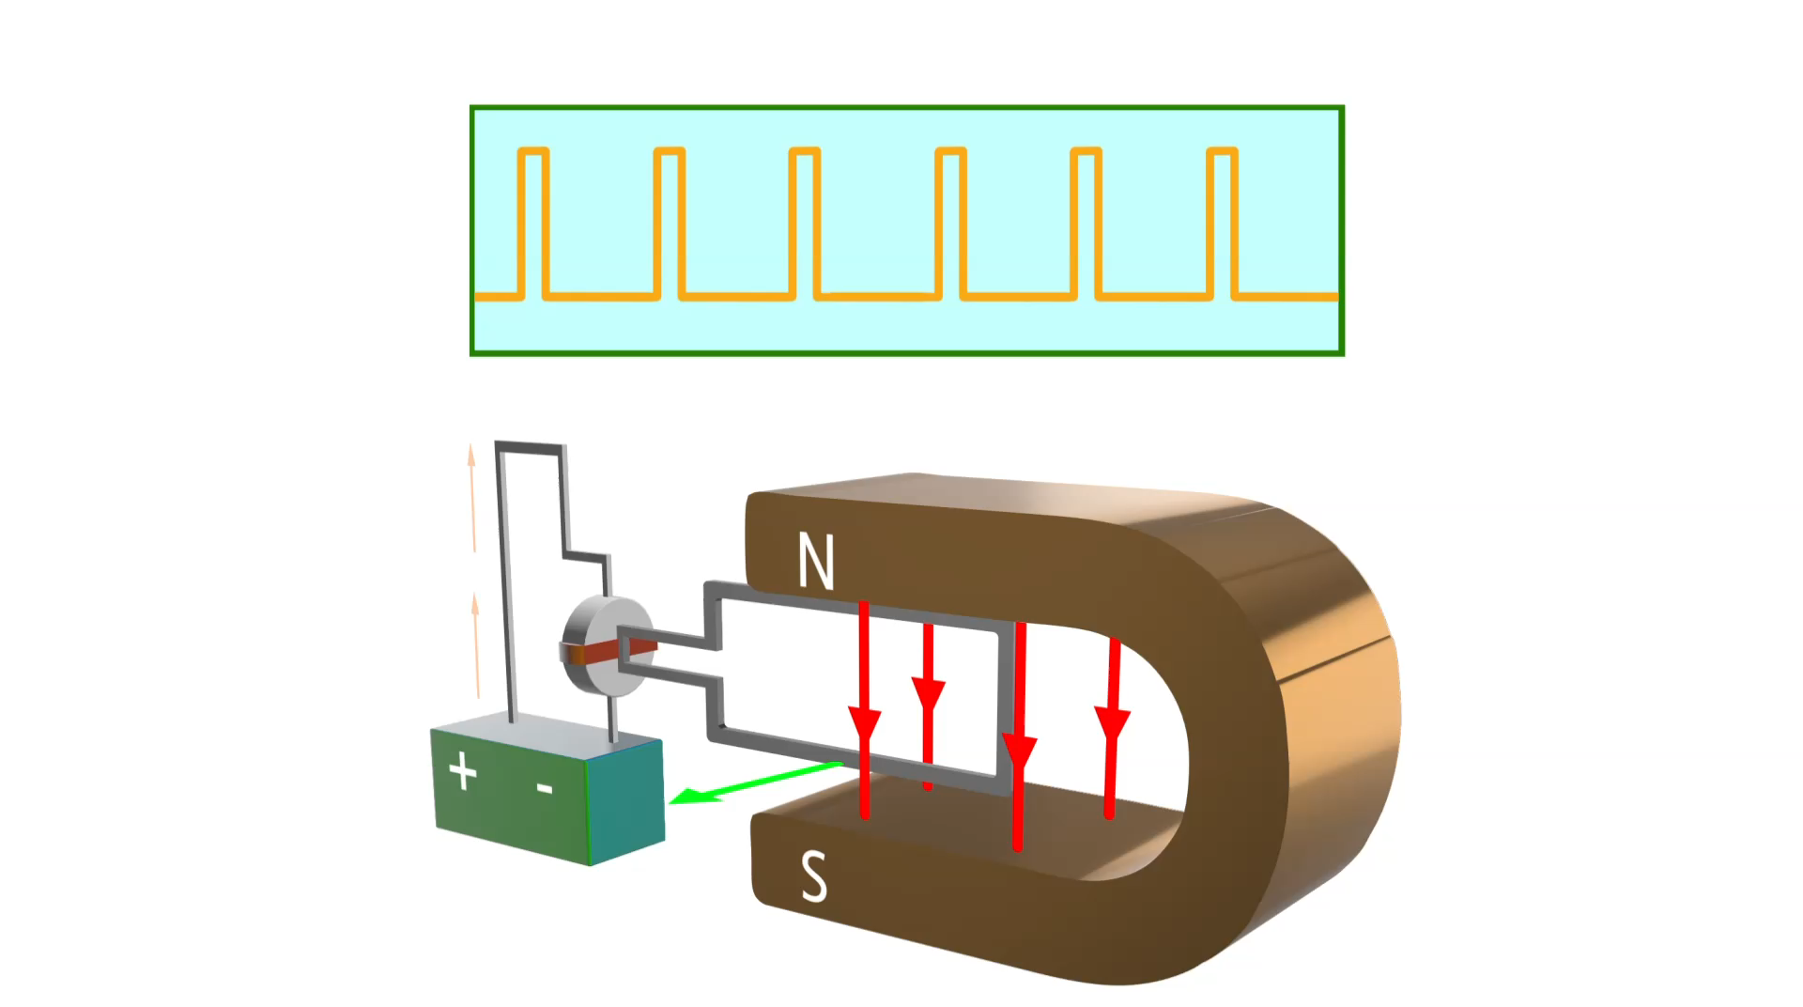
CONTROLLING DC MOTORS
Pulse width modulation
Duty Cycle = 10%
Click animation to play

Slide 12
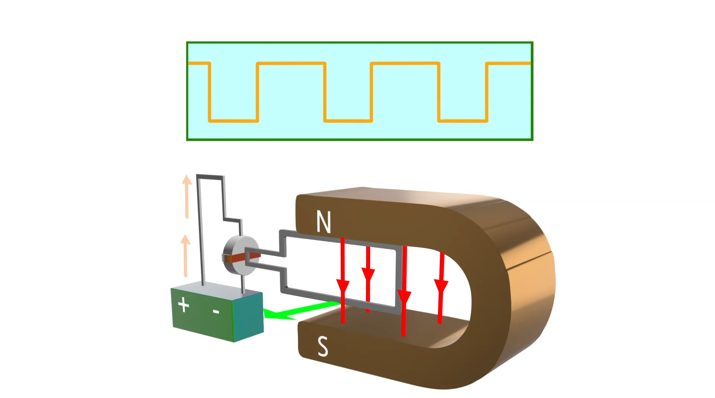
CONTROLLING DC MOTORS
Pulse width modulation
Duty Cycle = 50%
Click animation to play

Slide 13
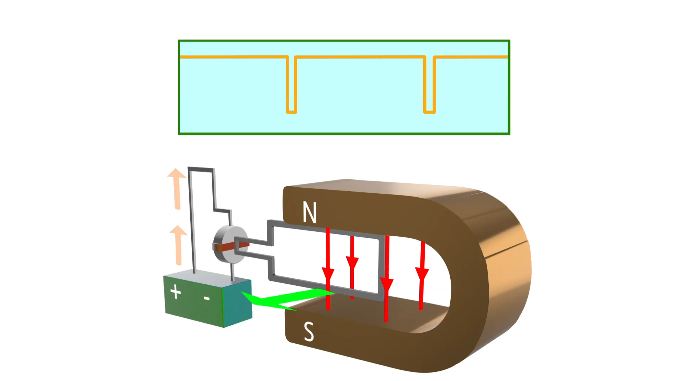
CONTROLLING DC MOTORS
Pulse width modulation
Duty Cycle = 90%
Click animation to play

Slide 14
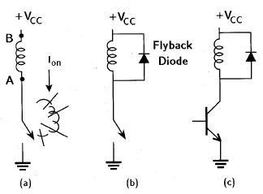
CONTROLLING DC MOTORS
INDUCTIVE KICKBACK
The steady-state current though an inductor, I_{on}, cannot immediately go to zero when the switch is opened. The changing current induces a voltage across the inductor, making the potential A greater than B, causing the switch to ‘blow up’
Kickback or flyback diode protects the switch (physical or transistor) from blowing up
flyback / kickback
diode

Slide 15
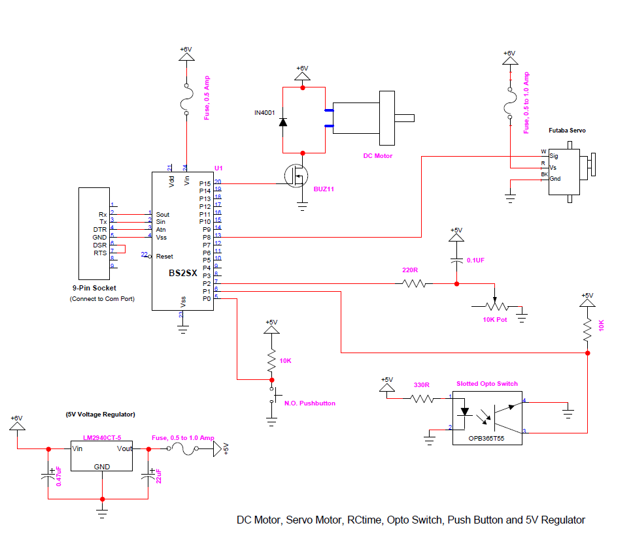
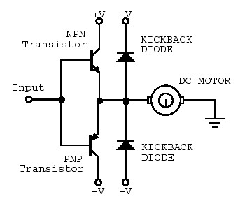
CONTROLLING DC MOTORS
PWM (Uni-direction)
PWM (Bi-direction)
MCU
Bi-directional DC motor control using a dual power supply

Slide 16
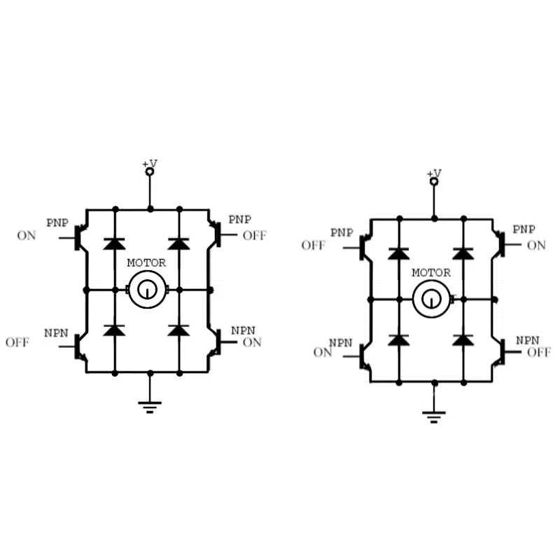
DCM DRIVING: GENERAL PWM
PWM bi-directional control with H-bridge circuit
Click animation to play

Slide 17
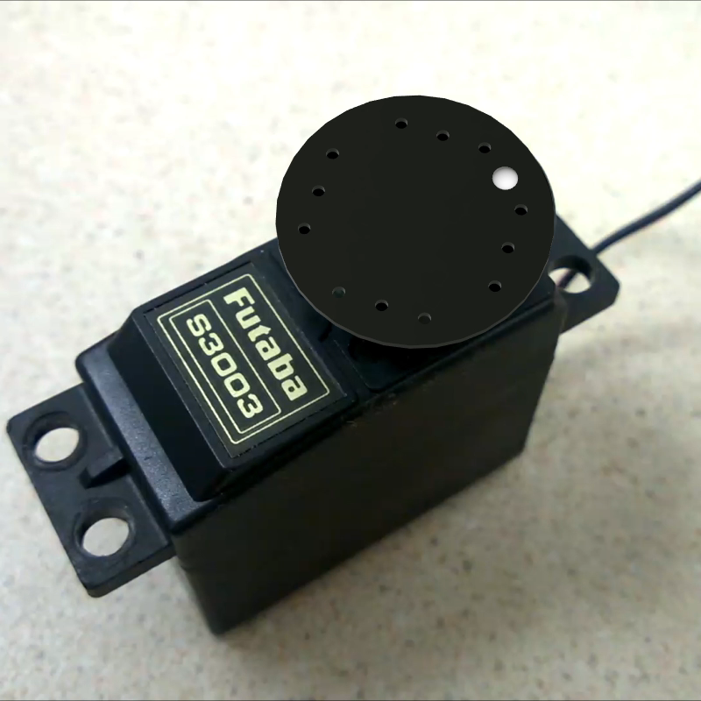

SERVO MOTOR
The drive flange can rotate ½ revolution
It is driven by width of high pulse (Logic 1) called ‘Mark’ length
0° to 180°
Mark
Space
Click video to play

Slide 18
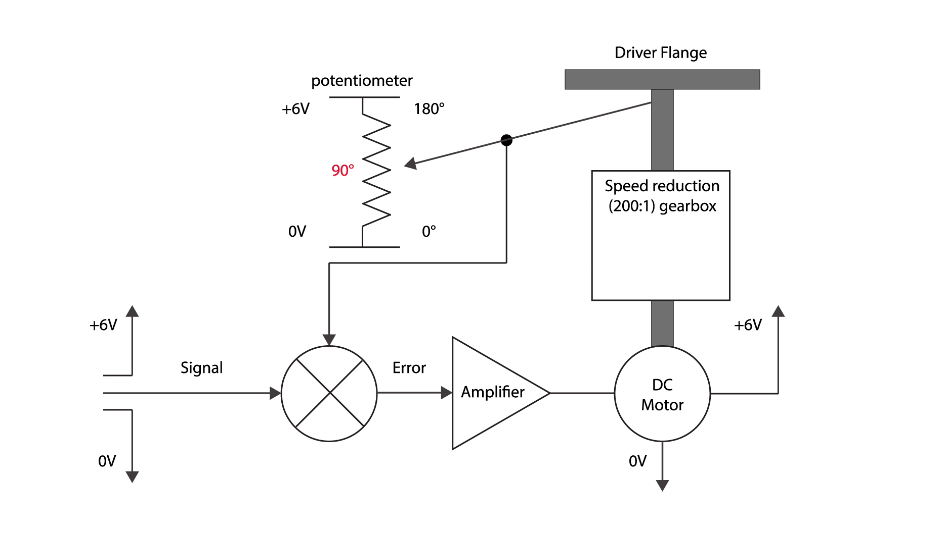
SERVO MOTOR
Working Principle
Click animation to play

Slide 19
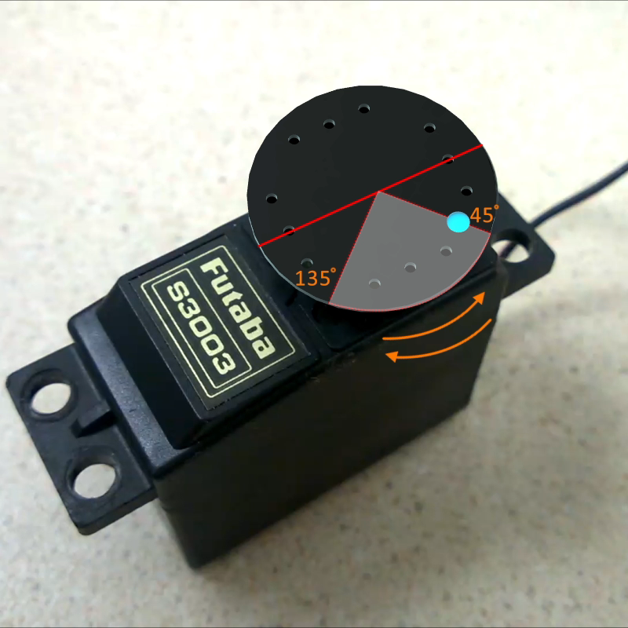
DRIVING A SERVO MOTOR
45° to 135°
Drive flange rotation (°)
180
135
Safe range
90
45
Click video to play
Mark Length (ms)
0
0.5
1.0
1.5
2.0
2.5

Slide 20
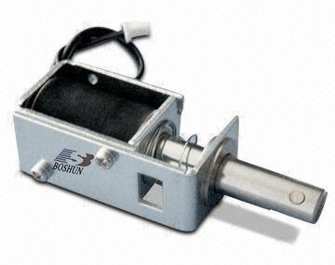
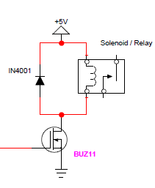
Solenoid
Construction
Stationary iron frame (stator)
Coil (solenoid)
Ferromagnetic plunger (armature)
Types
Push or pull
Control
A pulse to turn on or off
Spring
Plunger
Coil
Frame

Slide 21
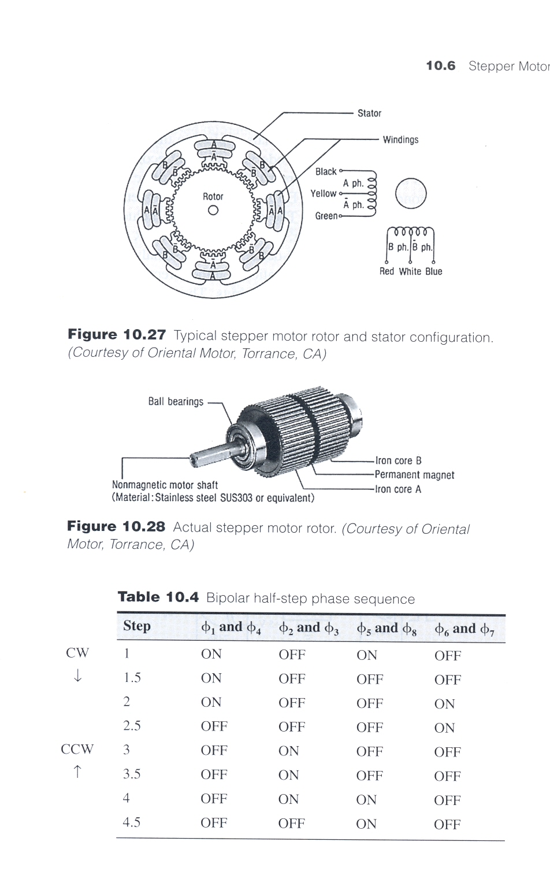
STEPPER MOTOR WORKING PRINCIPLE
Construction
Permanent magnet rotor
Stator with rotating magnetic field
if just one winding of the motor is energized, the rotor will snap (rotate) to a fixed angle and then hold that angle until the torque exceeds the holding torque of the motor.
Stator
Windings
Rotor & Stator Configuration
Stepper Motor Construction

Slide 22
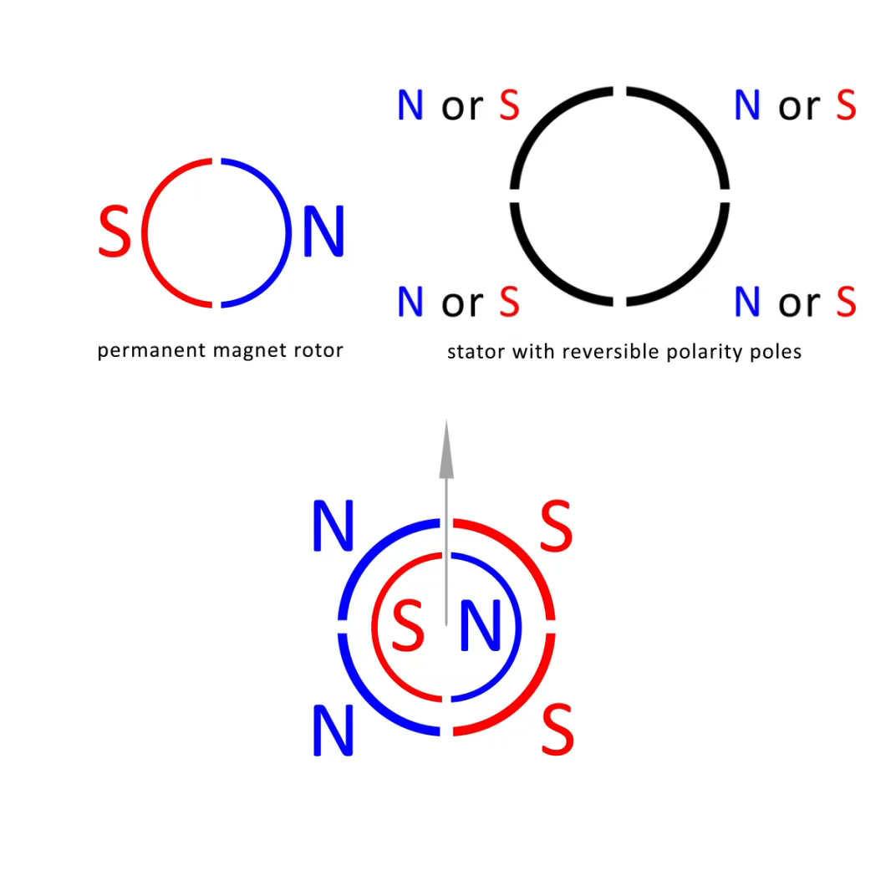
STEPPER MOTOR WORKING PRINCIPLE
Click animation to play

Slide 23
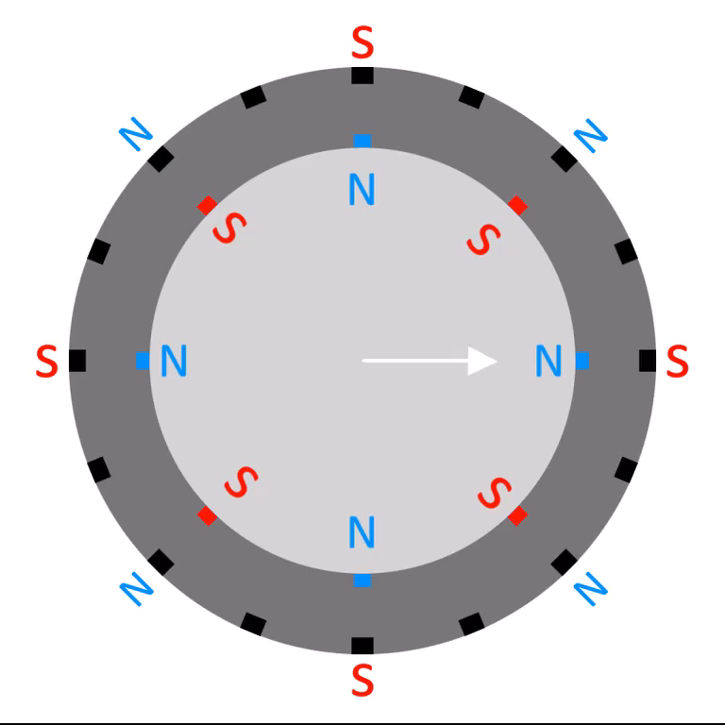
STEP SEQUENCE – HIGHER RESOLUTION
Double the number of poles will half the step size
Click animation to play

Slide 24
MICRO-STEPPING
Higher resolution can be achieved by controlling the fractions of current flowing into poles A & B individually
See URL

Slide 25
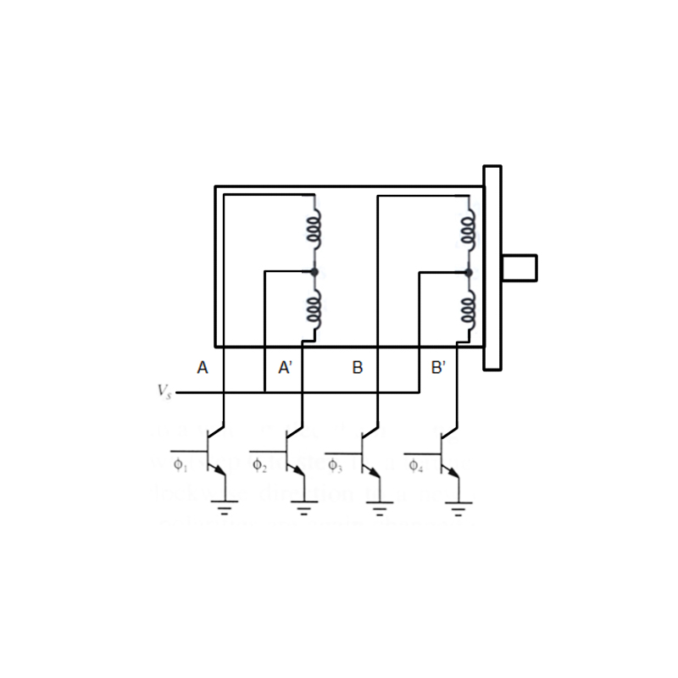
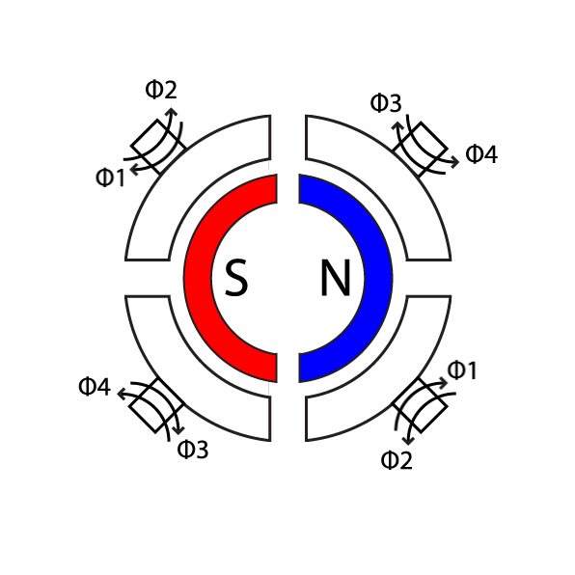
STEPPING SEQUENCE (WAVE-DRIVE / SINGLE PHASE)
Step | A (φ₁) | B (φ₃) | A’ (φ₂) | B’ (φ₄)
1
2
3
4
Unipolar stepper motor
Step 0

Slide 26
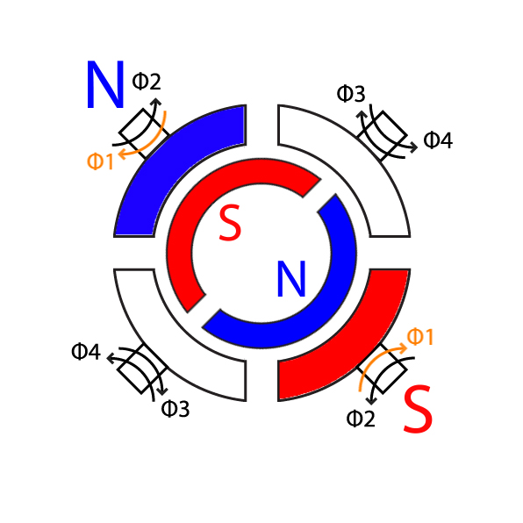
STEPPING SEQUENCE (WAVE-DRIVE / SINGLE PHASE)
Step | A (φ₁) | B (φ₃) | A’ (φ₂) | B’ (φ₄)
1 | ON
2
3
4
Unipolar stepper motor
Step 1

Slide 27
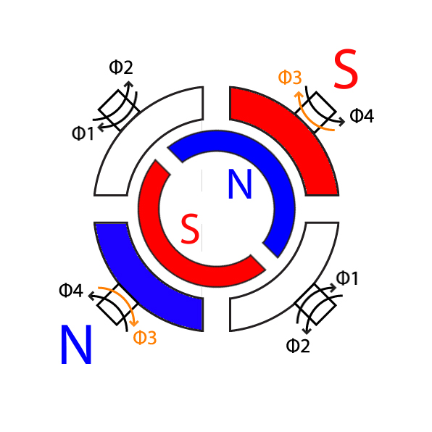
STEPPING SEQUENCE (WAVE-DRIVE / SINGLE PHASE)
Step | A (φ₁) | B (φ₃) | A’ (φ₂) | B’ (φ₄)
1
2 |  | ON
3
4
Unipolar stepper motor
Step 2

Slide 28
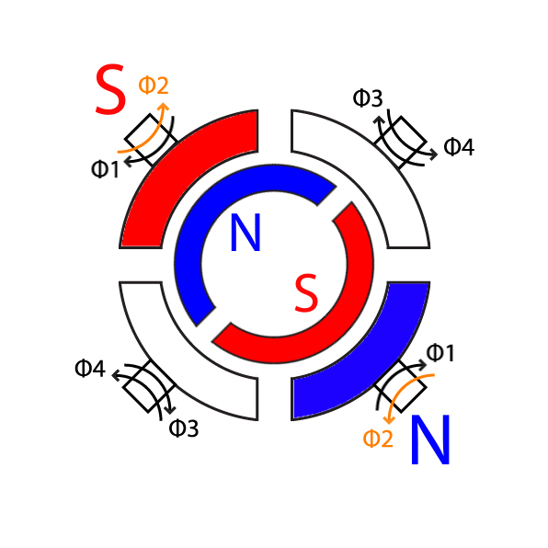
STEPPING SEQUENCE (WAVE-DRIVE / SINGLE PHASE)
Step | A (φ₁) | B (φ₃) | A’ (φ₂) | B’ (φ₄)
1
2
3 |  |  | ON
4
Unipolar stepper motor
Step 3

Slide 29
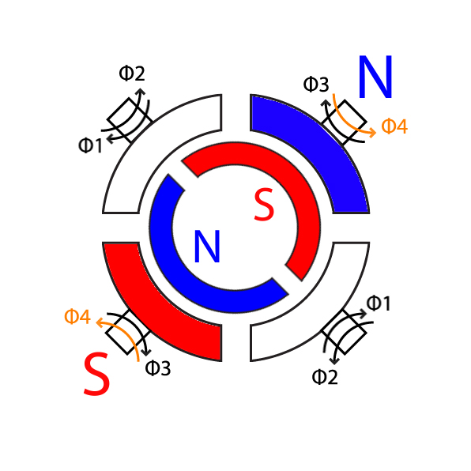
STEPPING SEQUENCE (WAVE-DRIVE / SINGLE PHASE)
Step | A (φ₁) | B (φ₃) | A’ (φ₂) | B’ (φ₄)
1
2
3
4 |  |  |  | ON
Unipolar stepper motor
Step 4

Slide 30
STEPPING SEQUENCE (WAVE-DRIVE / SINGLE PHASE)
Step | A (φ₁) | B (φ₃) | A’ (φ₂) | B’ (φ₄)
1 | ON
2
3
4
Unipolar stepper motor
Step 1

Slide 31
STEPPING SEQUENCE (2 PHASE FULL STEP)
Step | A (φ₁) | B (φ₃) | A’ (φ₂) | B’ (φ₄)
1
2
3
4
Unipolar stepper motor
Step 0

Slide 32
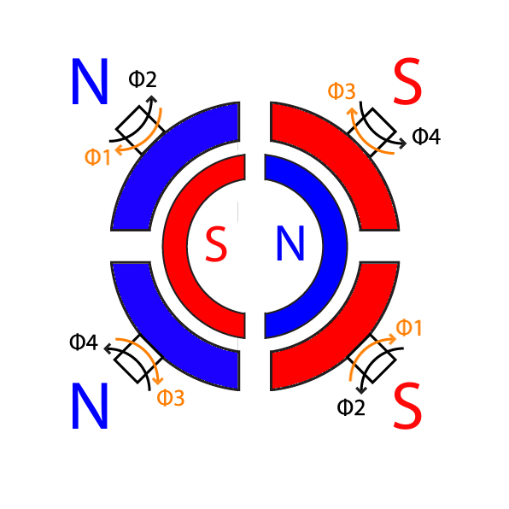
STEPPING SEQUENCE (2 PHASE FULL STEP)
Step | A (φ₁) | B (φ₃) | A’ (φ₂) | B’ (φ₄)
1 | ON | ON
2
3
4
Unipolar stepper motor
Step 1

Slide 33
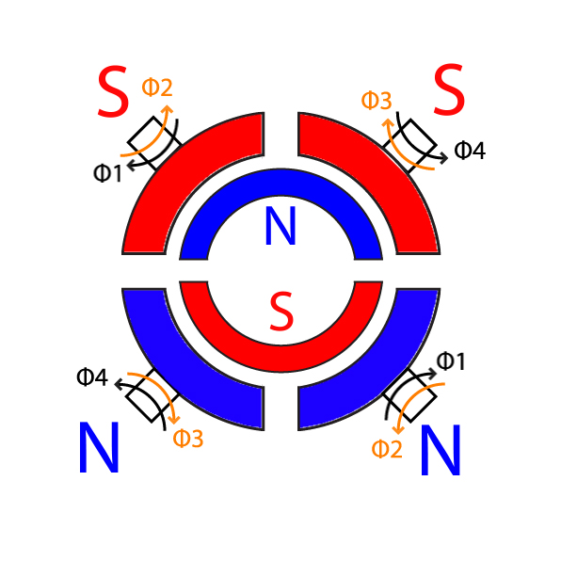
STEPPING SEQUENCE (2 PHASE FULL STEP)
Step | A (φ₁) | B (φ₃) | A’ (φ₂) | B’ (φ₄)
1
2 |  | ON | ON
3
4
Unipolar stepper motor
Step 2

Slide 34
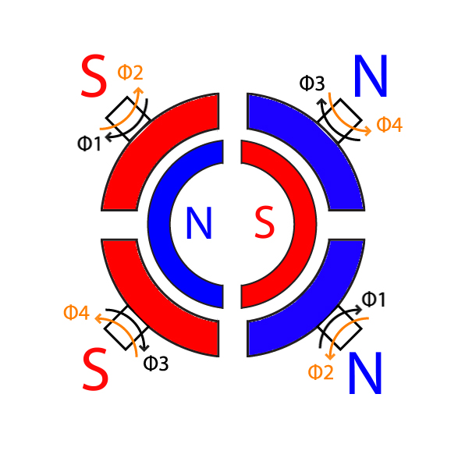
STEPPING SEQUENCE (2 PHASE FULL STEP)
Step | A (φ₁) | B (φ₃) | A’ (φ₂) | B’ (φ₄)
1
2
3 |  |  | ON | ON
4
Unipolar stepper motor
Step 3

Slide 35
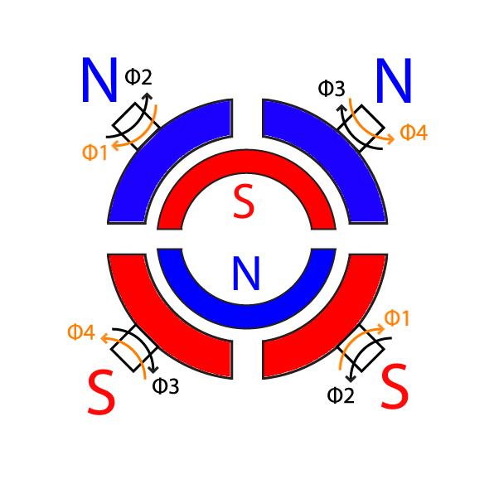
STEPPING SEQUENCE (2 PHASE FULL STEP)
Step | A (φ₁) | B (φ₃) | A’ (φ₂) | B’ (φ₄)
1
2
3
4 | ON |  |  | ON
Unipolar stepper motor
Step 4

Slide 36
STEPPING SEQUENCE (2 PHASE HALF STEP)
Step | A (φ₁) | B (φ₃) | A’ (φ₂) | B’ (φ₄)
1
1.5
2
2.5
3
3.5
4
4.5
Unipolar stepper motor
CCW: 1, 1.5, 2, 2.5, 3, 3.5, 4, 4.5, 1…
CW: 1, 4.5, 4, 3.5, 3, 2.5, 2, 1.5, 1…
Step 0

Slide 37
STEPPING SEQUENCE (2 PHASE HALF STEP)
Step | A (φ₁) | B (φ₃) | A’ (φ₂) | B’ (φ₄)
1 | ON | ON
1.5
2
2.5
3
3.5
4
4.5
Unipolar stepper motor
CCW: 1, 1.5, 2, 2.5, 3, 3.5, 4, 4.5, 1…
CW: 1, 4.5, 4, 3.5, 3, 2.5, 2, 1.5, 1…
Step 1

Slide 38
STEPPING SEQUENCE (2 PHASE HALF STEP)
Step | A (φ₁) | B (φ₃) | A’ (φ₂) | B’ (φ₄)
1
1.5 |  | ON
2
2.5
3
3.5
4
4.5
Unipolar stepper motor
CCW: 1, 1.5, 2, 2.5, 3, 3.5, 4, 4.5, 1…
CW: 1, 4.5, 4, 3.5, 3, 2.5, 2, 1.5, 1…
Step 1.5

Slide 39
STEPPING SEQUENCE (2 PHASE HALF STEP)
Step | A (φ₁) | B (φ₃) | A’ (φ₂) | B’ (φ₄)
1
1.5
2 |  | ON | ON
2.5
3
3.5
4
4.5
Unipolar stepper motor
CCW: 1, 1.5, 2, 2.5, 3, 3.5, 4, 4.5, 1…
CW: 1, 4.5, 4, 3.5, 3, 2.5, 2, 1.5, 1…
Step 2

Slide 40
STEPPING SEQUENCE (2 PHASE HALF STEP)
Step | A (φ₁) | B (φ₃) | A’ (φ₂) | B’ (φ₄)
1
1.5
2
2.5 |  |  | ON
3
3.5
4
4.5
Unipolar stepper motor
CCW: 1, 1.5, 2, 2.5, 3, 3.5, 4, 4.5, 1…
CW: 1, 4.5, 4, 3.5, 3, 2.5, 2, 1.5, 1…
Step 2.5

Slide 41
STEPPING SEQUENCE (2 PHASE HALF STEP)
Step | A (φ₁) | B (φ₃) | A’ (φ₂) | B’ (φ₄)
1
1.5
2
2.5
3 |  |  | ON | ON
3.5
4
4.5
Unipolar stepper motor
CCW: 1, 1.5, 2, 2.5, 3, 3.5, 4, 4.5, 1…
CW: 1, 4.5, 4, 3.5, 3, 2.5, 2, 1.5, 1…
Step 3

Slide 42
STEPPING SEQUENCE (2 PHASE HALF STEP)
Step | A (φ₁) | B (φ₃) | A’ (φ₂) | B’ (φ₄)
1
1.5
2
2.5
3
3.5 |  |  |  | ON
4
4.5
Unipolar stepper motor
CCW: 1, 1.5, 2, 2.5, 3, 3.5, 4, 4.5, 1…
CW: 1, 4.5, 4, 3.5, 3, 2.5, 2, 1.5, 1…
Step 3.5

Slide 43
STEPPING SEQUENCE (2 PHASE HALF STEP)
Step | A (φ₁) | B (φ₃) | A’ (φ₂) | B’ (φ₄)
1
1.5
2
2.5
3
3.5
4 | ON |  |  | ON
4.5
Unipolar stepper motor
CCW: 1, 1.5, 2, 2.5, 3, 3.5, 4, 4.5, 1…
CW: 1, 4.5, 4, 3.5, 3, 2.5, 2, 1.5, 1…
Step 4

Slide 44
STEPPING SEQUENCE (2 PHASE HALF STEP)
Step | A (φ₁) | B (φ₃) | A’ (φ₂) | B’ (φ₄)
1
1.5
2
2.5
3
3.5
4
4.5 | ON
Unipolar stepper motor
CCW: 1, 1.5, 2, 2.5, 3, 3.5, 4, 4.5, 1…
CW: 1, 4.5, 4, 3.5, 3, 2.5, 2, 1.5, 1…
Step 4.5

Slide 45
STEPPING SEQUENCE (2 PHASE HALF STEP)
Step | A (φ₁) | B (φ₃) | A’ (φ₂) | B’ (φ₄)
1 | ON | ON
1.5
2
2.5
3
3.5
4
4.5
Unipolar stepper motor
CCW: 1, 1.5, 2, 2.5, 3, 3.5, 4, 4.5, 1…
CW: 1, 4.5, 4, 3.5, 3, 2.5, 2, 1.5, 1…
Step 1

Slide 46
STEPPING SEQUENCE (2 PHASE HALF STEP)
Step | A (φ₁) | B (φ₃) | A’ (φ₂) | B’ (φ₄)
1
1.5
2
2.5
3
3.5
4
4.5 | ON
Unipolar stepper motor
CCW: 1, 1.5, 2, 2.5, 3, 3.5, 4, 4.5, 1…
CW: 1, 4.5, 4, 3.5, 3, 2.5, 2, 1.5, 1…
Step 4.5

Slide 47
STEPPING SEQUENCE (2 PHASE HALF STEP)
Step | A (φ₁) | B (φ₃) | A’ (φ₂) | B’ (φ₄)
1
1.5
2
2.5
3
3.5
4 | ON |  |  | ON
4.5
Unipolar stepper motor
CCW: 1, 1.5, 2, 2.5, 3, 3.5, 4, 4.5, 1…
CW: 1, 4.5, 4, 3.5, 3, 2.5, 2, 1.5, 1…
Step 4

Slide 48
STEPPING SEQUENCE (2 PHASE HALF STEP)
Step | A (φ₁) | B (φ₃) | A’ (φ₂) | B’ (φ₄)
1
1.5
2
2.5
3
3.5 |  |  |  | ON
4
4.5
Unipolar stepper motor
CCW: 1, 1.5, 2, 2.5, 3, 3.5, 4, 4.5, 1…
CW: 1, 4.5, 4, 3.5, 3, 2.5, 2, 1.5, 1…
Step 3.5

Slide 49
STEPPING SEQUENCE (2 PHASE HALF STEP)
Step | A (φ₁) | B (φ₃) | A’ (φ₂) | B’ (φ₄)
1
1.5
2
2.5
3 |  |  | ON | ON
3.5
4
4.5
Unipolar stepper motor
CCW: 1, 1.5, 2, 2.5, 3, 3.5, 4, 4.5, 1…
CW: 1, 4.5, 4, 3.5, 3, 2.5, 2, 1.5, 1…
Step 3

Slide 50
STEPPING SEQUENCE (2 PHASE HALF STEP)
Step | A (φ₁) | B (φ₃) | A’ (φ₂) | B’ (φ₄)
1
1.5
2
2.5 |  |  | ON
3
3.5
4
4.5
Unipolar stepper motor
CCW: 1, 1.5, 2, 2.5, 3, 3.5, 4, 4.5, 1…
CW: 1, 4.5, 4, 3.5, 3, 2.5, 2, 1.5, 1…
Step 2.5

Slide 51
STEPPING SEQUENCE (2 PHASE HALF STEP)
Step | A (φ₁) | B (φ₃) | A’ (φ₂) | B’ (φ₄)
1
1.5
2 |  | ON | ON
2.5
3
3.5
4
4.5
Unipolar stepper motor
CCW: 1, 1.5, 2, 2.5, 3, 3.5, 4, 4.5, 1…
CW: 1, 4.5, 4, 3.5, 3, 2.5, 2, 1.5, 1…
Step 2

Slide 52
STEPPING SEQUENCE (2 PHASE HALF STEP)
Step | A (φ₁) | B (φ₃) | A’ (φ₂) | B’ (φ₄)
1
1.5 |  | ON
2
2.5
3
3.5
4
4.5
Unipolar stepper motor
CCW: 1, 1.5, 2, 2.5, 3, 3.5, 4, 4.5, 1…
CW: 1, 4.5, 4, 3.5, 3, 2.5, 2, 1.5, 1…
Step 1.5

Slide 53
STEPPING SEQUENCE (2 PHASE HALF STEP)
Step | A (φ₁) | B (φ₃) | A’ (φ₂) | B’ (φ₄)
1 | ON | ON
1.5
2
2.5
3
3.5
4
4.5
Unipolar stepper motor
CCW: 1, 1.5, 2, 2.5, 3, 3.5, 4, 4.5, 1…
CW: 1, 4.5, 4, 3.5, 3, 2.5, 2, 1.5, 1…
Step 1

Slide 54
SUMMARY
Direct current motor
Construction
Brushed vs Brushless
Control
Pulse Width Modulation (PWM)
Inductive Kickback & Diode protection
SERVO MOTOR
Working principle
Control: Mark length

Slide 55
SUMMARY
solenoid
Construction & Control
Stepper motor
Construction & Working Principle
Control
Wave Drive / Single Phase
Two Phase Full Step
Two Phase Half Step
Microstepping

